Slide 1
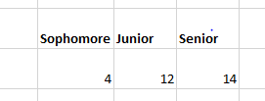
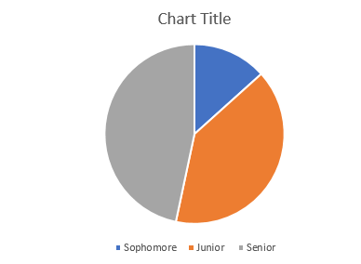


Slide 2


Slide 3
What concerns do you have about working on a student group project?
not doing enough work so that i will fully get the subject down, so i sometimes work alone
Everyone doing an equal amount of work.
not being able to meet outside of class and people not doing their work
One person not working
No concerns.
communication and availability to work on it as a group
none
Time management and organizing times with others.
Not doing there part, or just doing there part and not helping
Achieving a good workflow as a team can be difficult.
Everyone in the group contributing and completing their respective parts.
how would we do it with remote learning?
That everyone does their part in the project
none
On time
No concerns
Scheduling, other classes with big projects also in groups
Just having everyone's schedules line up for meetings. Balancing the work with other group projects from other classes
Making sure that people stick to their "scheduled" meeting times to talk about the project
Just being online may make it hard.
N/A
None

Slide 4


Slide 5
C++
java 1 2 and 3
ai
Intro to robotics
System Analysis and design,
Unix/Linux
Intro to Robotics, Intro to Mobile App Dev
"CSC3800, CSC2400, etc."
Intro to Unix/Linux at Waubonsee Community college
"Artificial Intelligence, Web App I, UNIX and Linux Admin"
Operating Systems, Web App 1 and 2, Artificial Intelligence, Systems Analysis and Design
4100
Web App 2
None at AU, though, I have previously taken C++ and PHP.
"Artificial Intelligence, C++, Operating Systems, Systems Analysis and Design"
I have taken Unix/Linux, C++ for Java Developers, Artificial Intelligence.
none
What CSC electives have you completed?

Slide 6
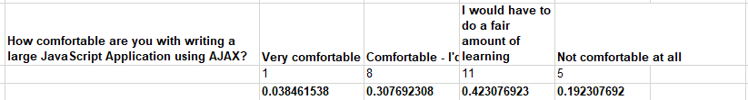

Slide 7
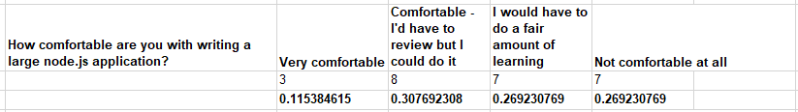
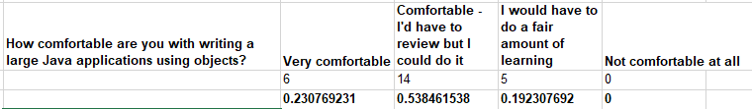

Slide 8

none
no idea
Not sure
Have a way to prove who did what
Not really
Do a quick survey about who did what and to rank how involved they were in the project. I am used to being in person when we work on code instead of zoom.
Nothing really, had a great time with project buddies!!
The earlier the project starts the better
we pick the groups
No suggestions that I can think of.
Having portion of the grade that is about the quality and quantity of the work you specifically did.
Peer Reviews work
fair groups and specific projects
N/A
For the groups to be even.
-
Give adequite time to be able to work around peoples schedules
N/A
Individual grades based on contribution.

Slide 9


Slide 10

No questions.
will there be a group project in this class?
Will we have a project
none
N/A
None
Just balancing the coursework with other classes
I am super excited for this course. I am a computer science major but my interest lies in cyber security specifically. With the way my credits transferred from Waubonsee Community College computer science made it easier to graduate on time.
None
what would we be doing in class.
What technologies will we use
A concern would be falling behind in the class.
N/A
What kind of class is this?

